Slide 1
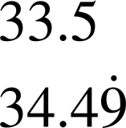
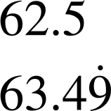
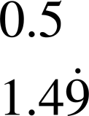
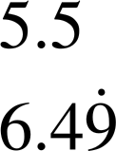
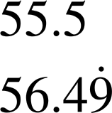
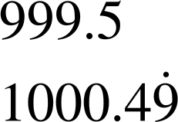
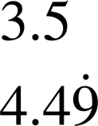
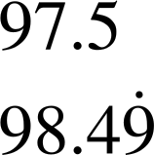
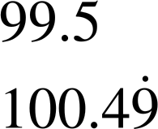
Inequality notation to express error
Task A: Range of values on a number line
1) Identify the range of unrounded values when:
a) 34 has been rounded to the nearest integer.
b) 63 has been rounded to the nearest integer.
c) 1 has been rounded to the nearest integer.
Smallest:
Largest:
Smallest:
Largest:
Smallest:
Largest:
2) Identify the range of unrounded values when:
a) 6 has been rounded to 1 s.f.
b) 56 has been rounded to the 2 s.f.
c) 1000 has been rounded to 4 s.f.
Smallest:
Largest:
Smallest:
Largest:
Smallest:
Largest:
3) Work out the question given the following:
a) 4 has been rounded to 1 s.f.
b) 98 has been rounded to the 2 s.f.
c) 100 has been rounded to the nearest integer.
Smallest:
Largest:
Smallest:
Largest:
Smallest:
Largest:

Slide 2
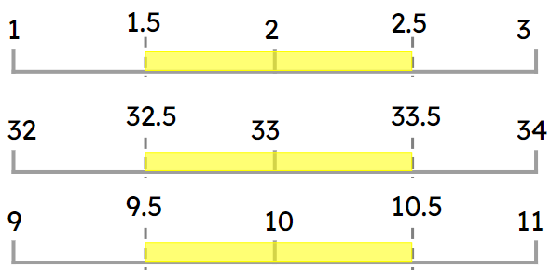
Inequality notation to express error
Task B: Error intervals
a) 2 rounded to 1 s.f.
b) 33 rounded to 2 s.f.
c) 10 rounded to 2 s.f.
Given the number lines, identify the error interval.
1.5 ≤ x < 2.5
32.5 ≤ x < 33.5
9.5 ≤ x < 10.5
2) Identify the error interval of the following:
a) 482 is rounded to the nearest whole number 481.5 ≤ x < 482.5
b) 65 is rounded to the 2 s.f. 64.5 ≤ x < 65.5
c) 7.2 is rounded to 1 d.p. 7.15 ≤ x < 7.25
d) 4.54 is rounded to 2 d.p. 4.535 ≤ x < 4.545
3) Pair up the question with the correct error interval
3 is rounded to 1 s.f.
3.15 ≤ x < 3.25
3.3 is rounded to 1 d.p.
3.245 ≤ x < 3.255
3.2 is rounded to 2 s.f.
2.5 ≤ x < 3.5
3.25 is rounded to 2 d.p.
3.25 ≤ x < 3.35
Mathematics in Education and Industry
v2.3

